Slide 1
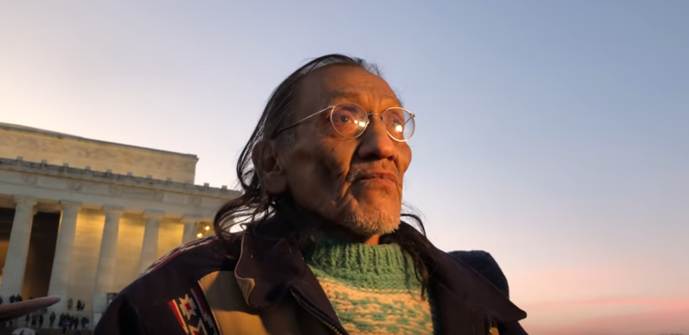
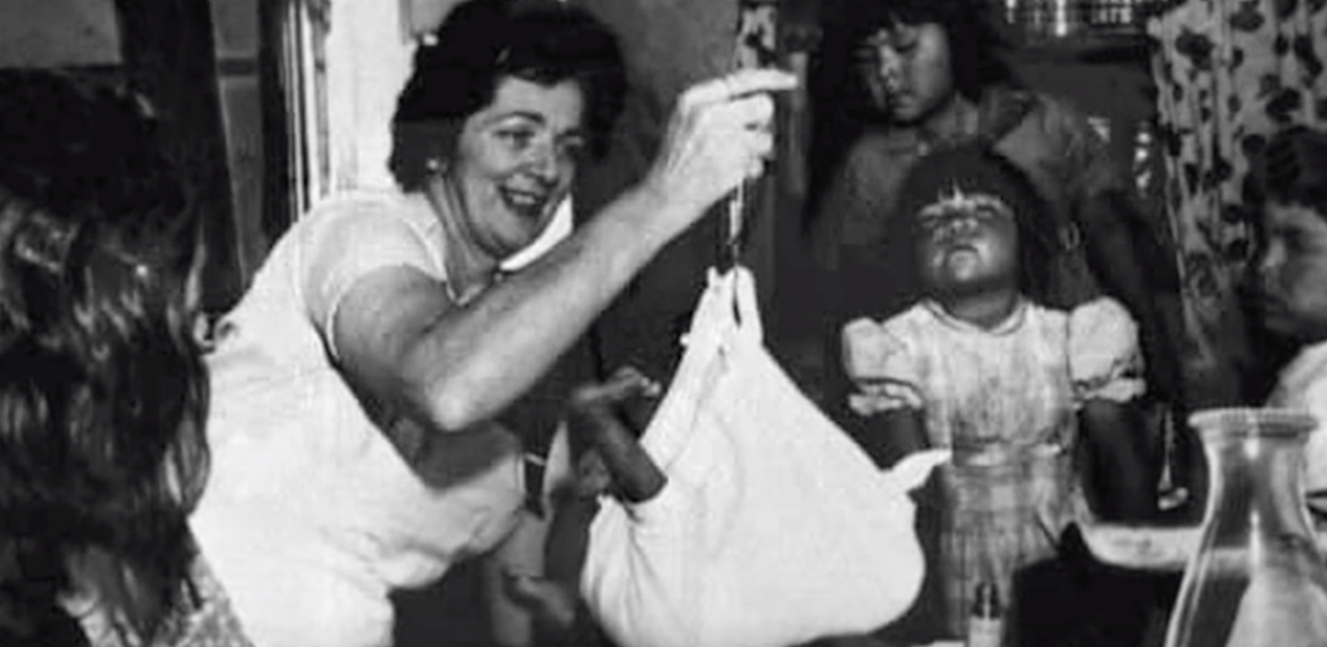
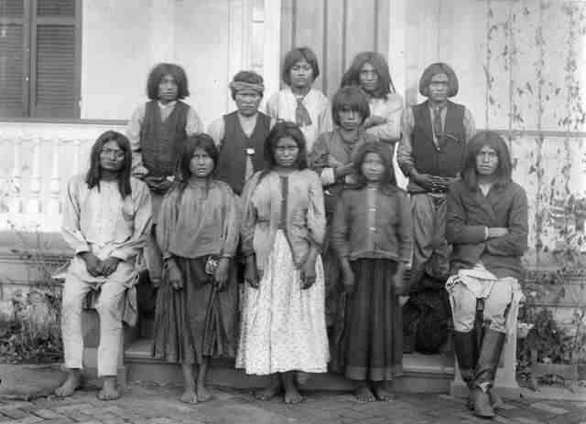
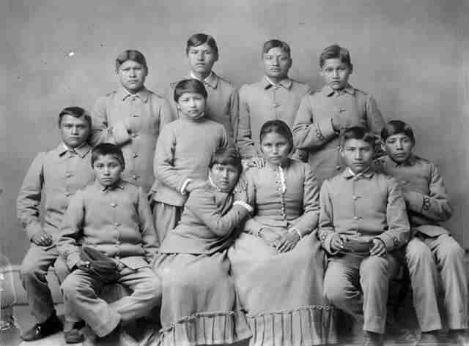
Nathan Phillips 2019
Indian Child Welfare Act 1978
Chiricahua political prisoners 1886 FL
Carlisle Indian School, 1886, PA

Slide 2
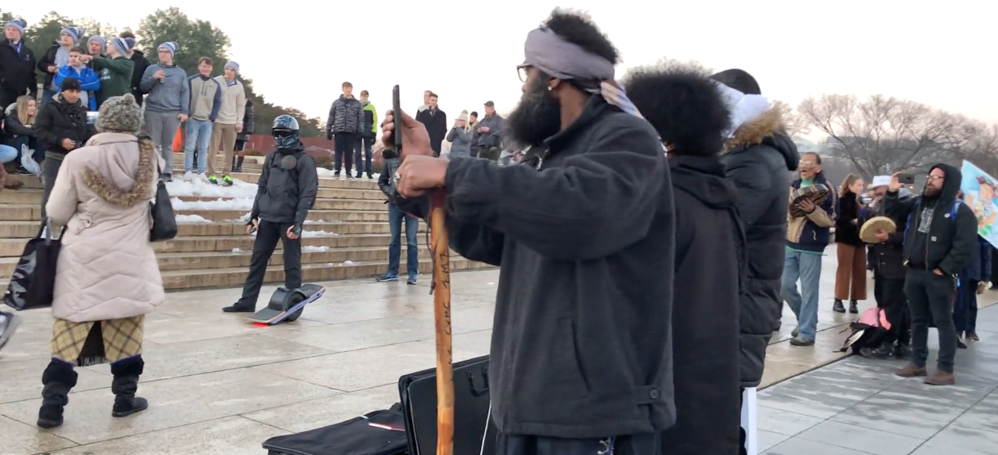
https://vimeo.com/312330750 @ 3:54

Slide 3
Reconciliation
The Drum
Native youth adoptions
https://www.youtube.com/watch?time_continue=5&v=8laqRi6CWWU
“This is Indigenous land”
Founder of the Native Youth Alliance
A native of Lincoln, Nebraska, and the youngest of 11, Phillips was taken from his mother at 5. He was raised by a white foster family with limited interaction with his Omaha tribe’s culture and biological family. It was at a time, he tells PEOPLE, when the United States had a policy of separating Native American children from their families. “I was told my mom was no good, I was told my dad was no good,” Phillips says. “When they were telling me these things I was being hit with a belt, with a fly swatter.”
Notes:
https://people.com/politics/nathan-phillips-interview-covington-catholic-student-video/

Slide 4
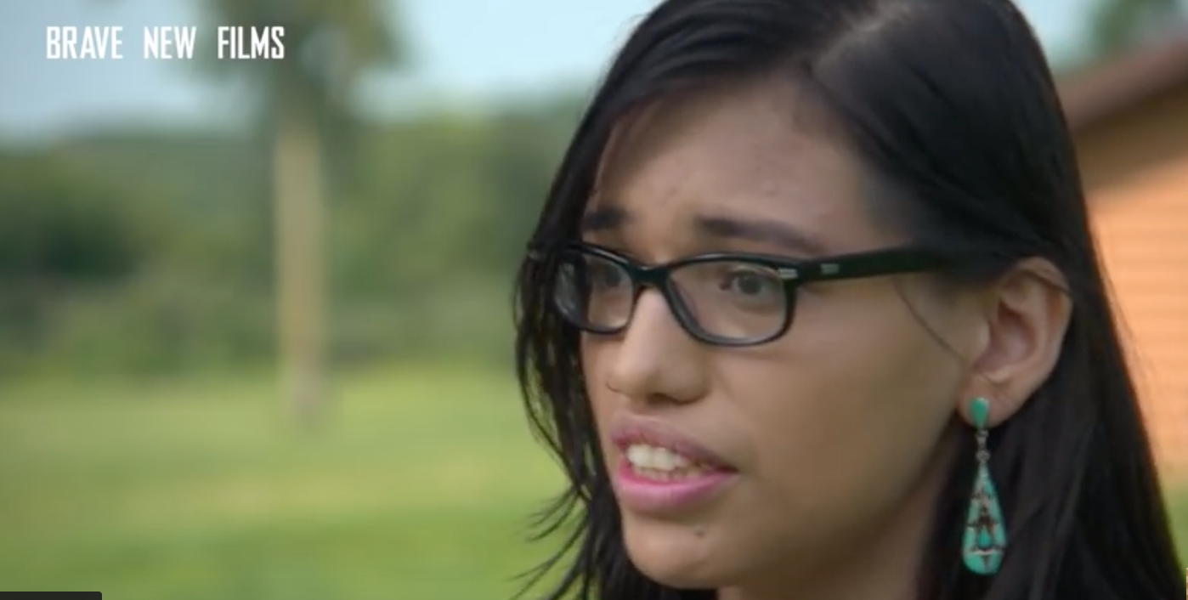
Alethea Phillips: Native Youth Alliance - https://www.youtube.com/watch?v=Zacn9Iw4HYU

Slide 5
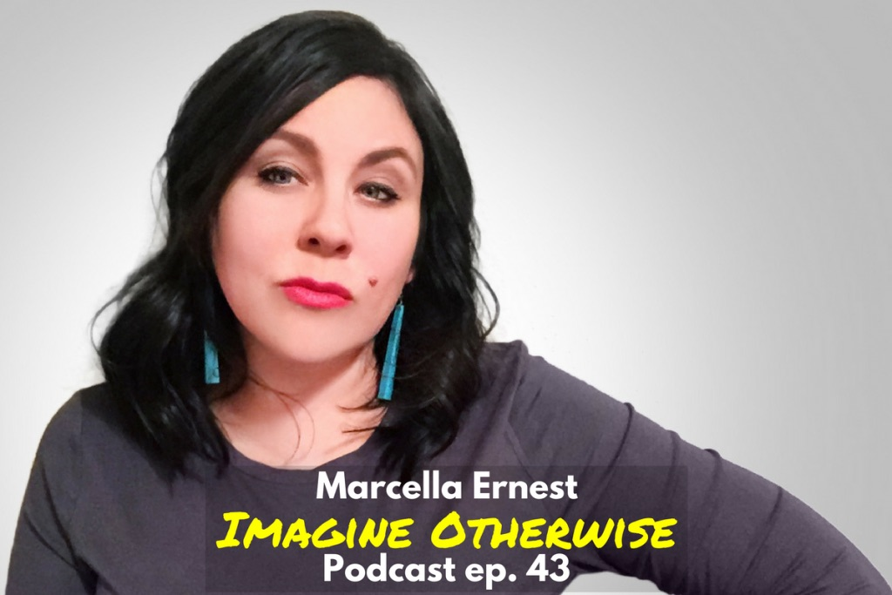
The Archive
…the curatorial strategies of embodiment, including the senses, possession, and emotional connections. Mithlo, “Blood Memory”
Blood relationships reference not only the common understanding of what is considered biological heritage or race but also, in an expanded sense, the internalized memories of communal history, knowledge, and wisdom. Blood memories are powerful political tropes mobilized to call attention to the legacies of colonialism in contexts as diverse as battlefields, boarding schools, and sacred sites. This common tribal value of multigenerational remembrance runs directly counter to prevailing Western traits of individual achievement, lack of transgenerational memory, and transcendence of one’s genealogical fate and place of origin.

Slide 6
Vocabulary from “Blood Memory” Marcella Ernest
Native feminisms – Drawing on stories of sisters, mothers, daughters. Not excluding, but positioning women as central.
Transnational citizenship – Existing in locations between nations. Recognition that tribal territories exceed political borders. Making place complicated – History placed upon our bodies, placed upon the land. Fluid borders
Ethnographic present - a description of a culture as it was prior to contact. In a decolonial reading, the tendency to romanticize and make stagnant living cultures. Associated : Authenticity (a belief in a pristine, imagined past, untainted by outside influences), Coevality (of the same age, era).
Lack of visual representations – Invisibility – “We have very little visuals to tell the stories of our grandmothers.” No markers to claim and name space.

Slide 7
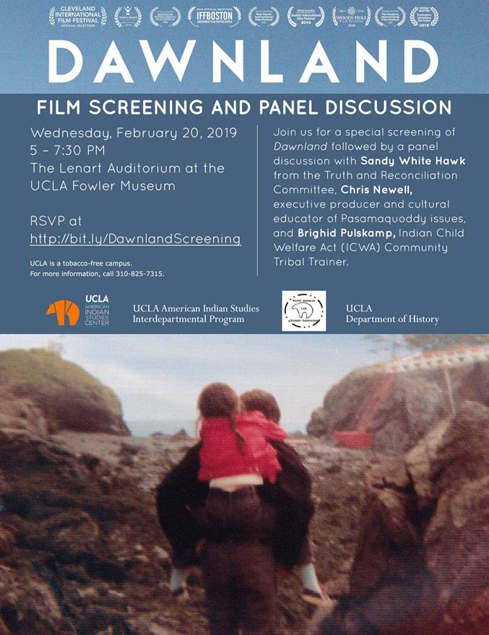
Dawnland
February 20, 2019
5:00 to 7:30
Fowler Museum

Slide 8
https://boardingschoolhealing.org/announcing-the-2019-boarding-school-healing-webinar-series/

Slide 9
Indian Child Welfare Act of 1978
The Indian Child Welfare Act (ICWA) was enacted in 1978 in response to a crisis affecting American Indian and Alaska Native children, families, and tribes. Studies revealed that large numbers of Native children were being separated from their parents, extended families, and communities by state child welfare and private adoption agencies. In fact, research found that 25%–35% of all Native children were being removed; of these, 85% were placed outside of their families and communities—even when fit and willing relatives were available.
Native families are four times more likely to have their children removed and placed in foster care than their White counterparts. So in spite of the advances achieved since 1978, ICWA’s protections are still needed.
https://www.nicwa.org/about-icwa/

Slide 10
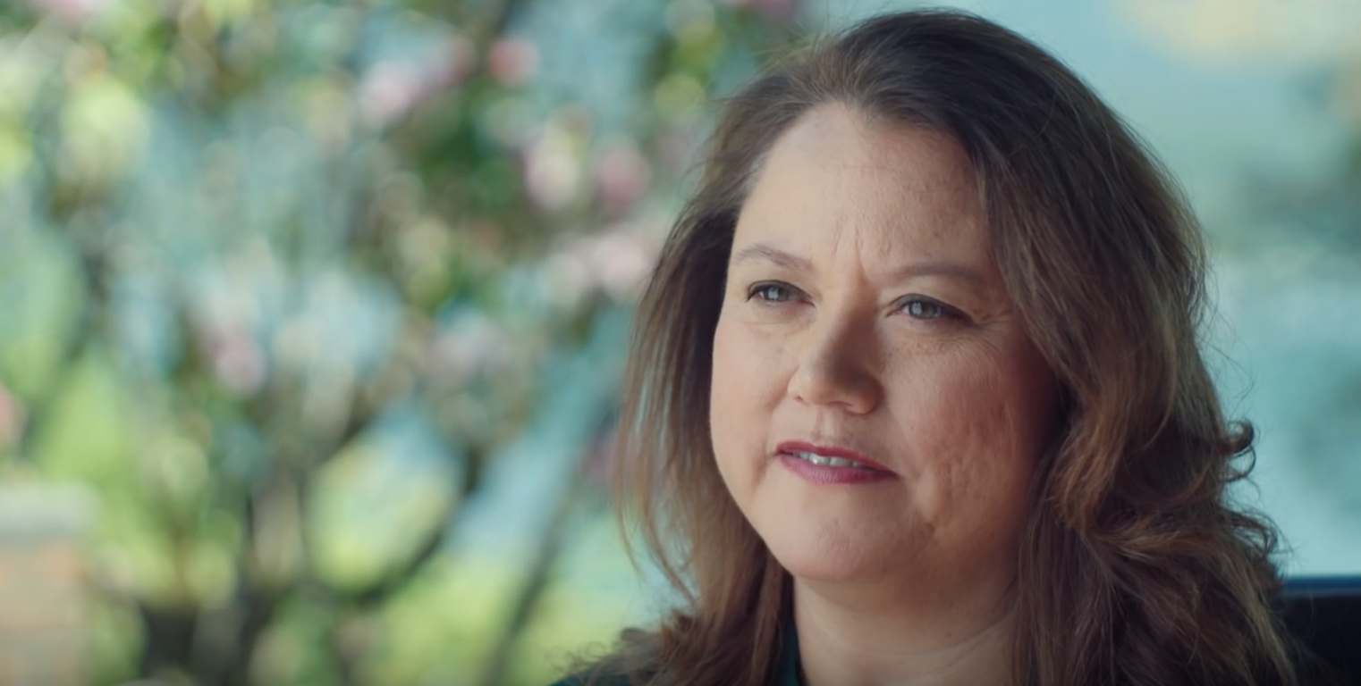
https://www.youtube.com/watch?time_continue=173&v=VpxlN7vL_lA

Slide 11
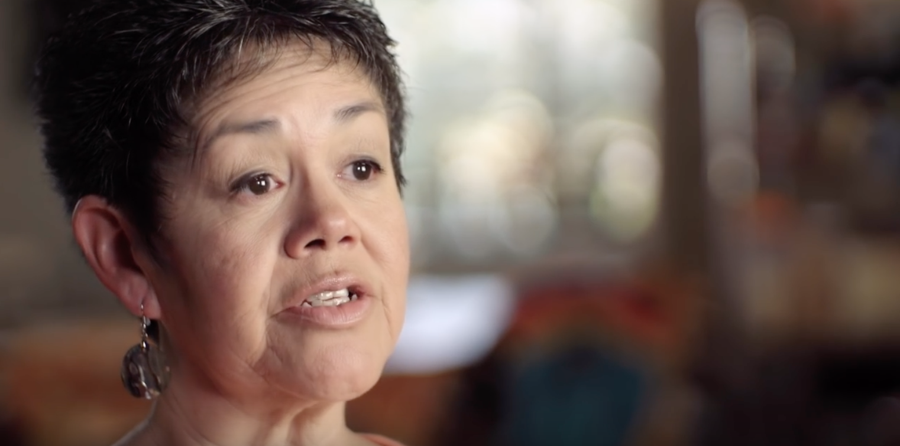
https://www.youtube.com/watch?v=tYMG13pKq4Y

